Slide 1

R³
^{(Reduce Reuse Recycle)}
Prototype Pitch
Patapsco Middle School - 6th Grade
Designed by: The RoboKnights
2017-2018
Harini Devireddy
Pragna Yalamanchili
Srinidhi Akella
Venya Karri

Slide 2

Problem Definition
A lot of recyclable items are being thrown into the trash and being sent to landfills everyday, this creates toxic chemicals that heat up the earth and contributes to global warming.
Another issue with recyclable items in landfills is that they don’t biodegrade quickly. In fact, it takes an average plastic water bottle 500 years to completely biodegrade.
Recyclable items can also be used to conduct energy, recycling a tin can conduct enough energy to run a TV for 2 hours! If we recycle more, it can save us a lot of energy.
Bottomline is inability to efficiently segregate Recyclable items from trash causes environmental pollution and opportunity lost in saving energy

Slide 3
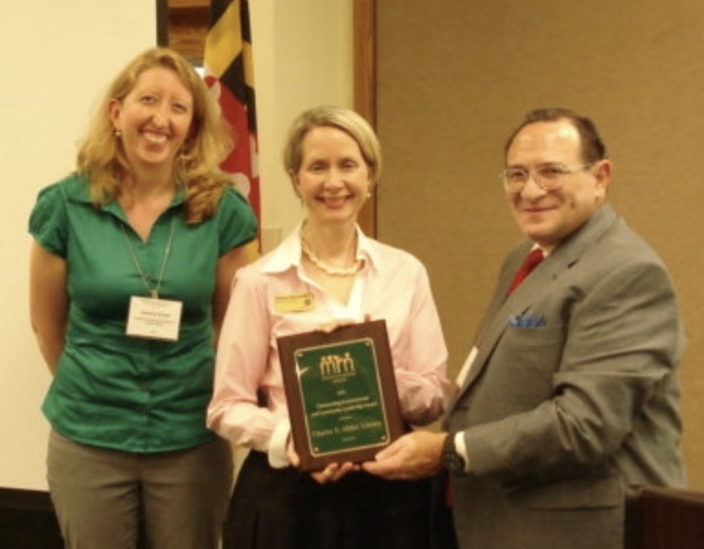
Client and Expectations
Our client is Gemma Evans, we originally send an email to Allan Kittleman, then he forwarded the email to her because she is the head of recycling coordination. She was very kind and responded to us quickly. In her email she gave us a couple of requirements and expectations for our device.
Below is our interpretation of expectations given to us:
Need a tool to identify recyclable items and restrict recyclable items to be intermixed with the trash
Efficient Proximity sensing of recyclable items
Needs to be weatherproof and avoid damage from trash inside the container
Needs to have display panel for friendly usability and buzzer prompting
Recyclables should be fed individually to container
Scope is limited for home usage - Needs further improvements for commercial usage

Slide 4
Current Solutions and their Weaknesses
Below are key findings based on our market research on existing solutions
There is no distinct product in market that can identify all types of recyclable items
None of the devices in the market, surprisingly is user friendly - don't have display, prompting and notification capabilities.
No device that can identify recyclable items that settled in trash bin, free flow to trash bin(W/O lid) and thrown into trash bin(with lid).
Bottomline is there is no efficient device that can restrict recyclable items from intermixing with trash.

Slide 5
Choices Made for Prototype
We considered the following solution choices for protype and selected option 1
Option 1: A device to identify trash and recyclable items throwing into the trash bin with lid
Option 2: A device to identify recyclable items throwing into (free flow) the trash bin without lid
Option 3: A device to identify recyclable items from the settled items of the trash bin
Given defined timeline we considered the following capabilities for this iteration but it has foundational framework that can be extendable for future releases.
Identification of few selected recyclable items - metal detection scope only
Individual loading of the items in trash bin
LCD display for prompts along with buzzer
Lid auto open/close based on identification of items
Residential usage only
Notes:
Go into more detail about each point

Slide 6
Advantages of Prototype
The device has foundational framework with focused capabilities but has potential to be fully extendable to meet broader diversified needs
Key Advantages
Minimizes intermixing of recyclable with trash in turn helps
Reduction of chemical toxic gases generation from Landfills
Increased Opportunity on recycling and saves energy
Key Strengths
Supports metal detection to avoid intermixing with trash and provides recycle opportunity
The device is very user friendly - displays a LCD message and buzzer to prompt user to recycle the item
If the item is recyclable, the lid does not automatically open

Slide 7
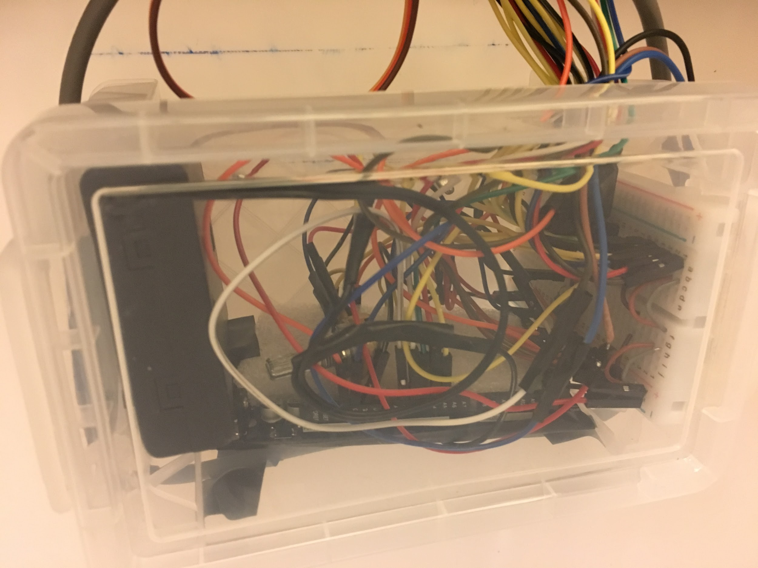
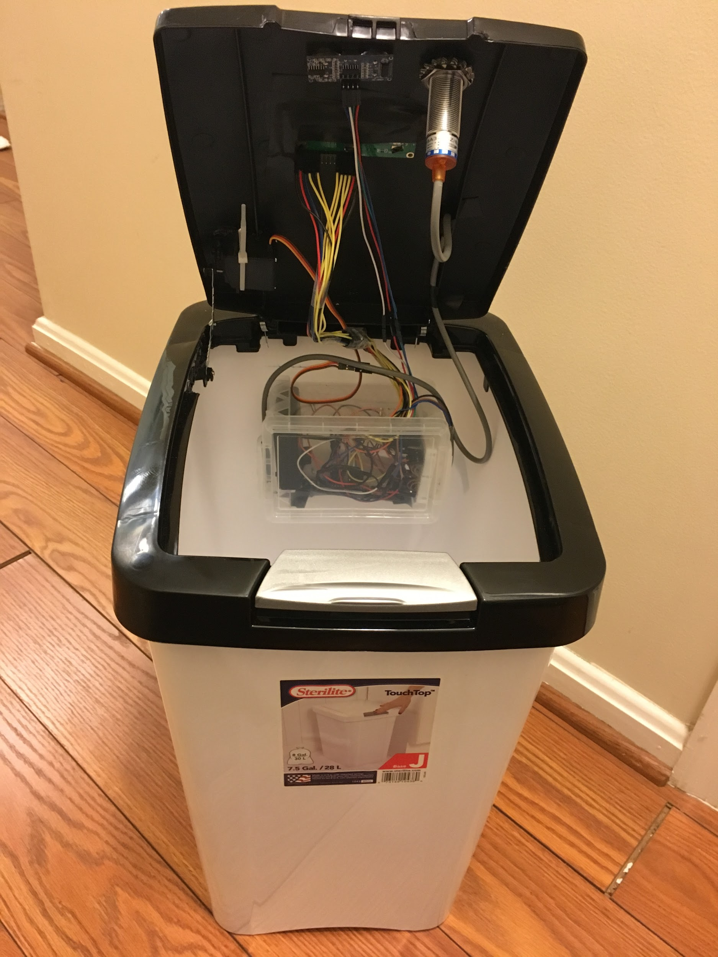
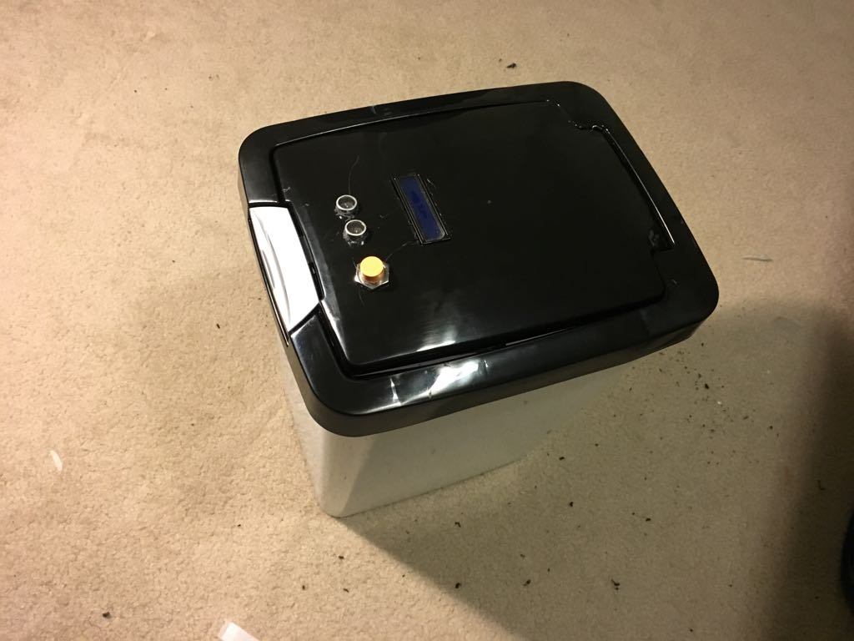
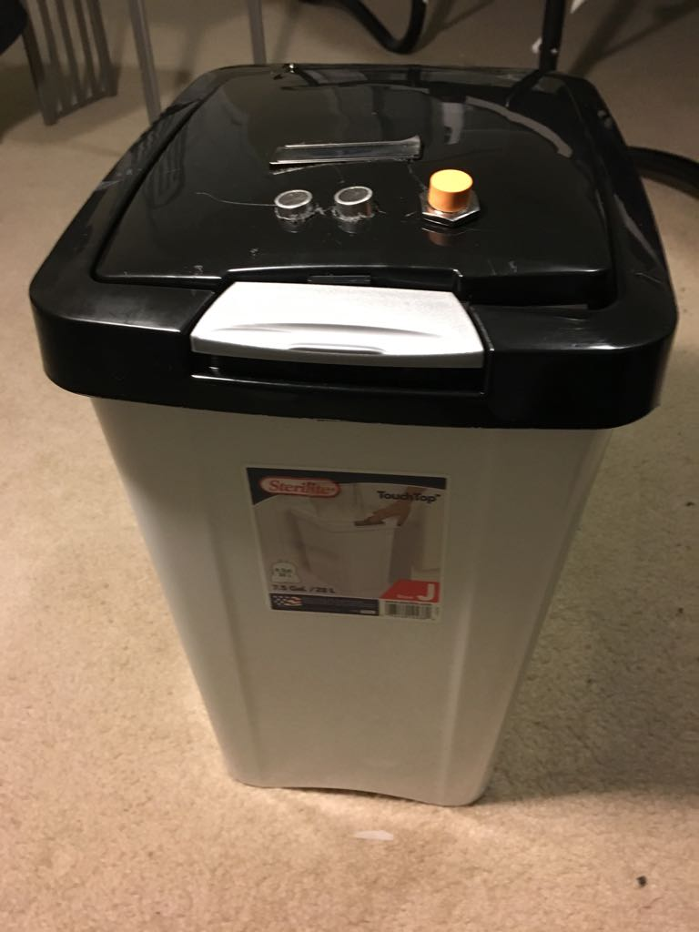
Prototype Demonstration

Slide 8

Next Steps for Design
Enabling below capabilities are been considered for future enhancements for multi iteration releases for full blown product
Plastic, cardboard, paper and glass sensor are must have capabilities
Notification to user’s phone with recyclable data is nice to have future
Extend product capabilities from residential to commercial usage.
Monthly reports to user telling them how much they have recycled

